Slide 1
PERFORMANCE INNOVATIVE TASK
A Greedy Solution to the
Traveling Salesperson Problem
A five-landmark tour of Cagayan de Oro City
NEAREST NEIGHBOR
PYTHON DEMONSTRATION
10–15 MINUTE VIDEO
Prepared for the TSP algorithm performance task | October 2026

Slide 2
GREEDY TSP / CAGAYAN DE ORO
The problem: visit every landmark, then return
Real-world scenario
TSP requirements
A city visitor wants to document five recognizable locations in one tour, starting and finishing at Gaston Park.
Visit each required landmark once, return to the starting location, and minimize the selected travel-distance measure.
Objective in this demonstration: minimize total modeled straight-line distance, in kilometers.
TSP • Greedy Nearest Neighbor • educational straight-line model
02

Slide 3
GREEDY TSP / CAGAYAN DE ORO
Five real locations in Cagayan de Oro
A
Gaston Park
8.475420° N, 124.642140° E
B
Plaza Divisoria
8.477750° N, 124.643778° E
C
Ayala Malls Centrio
8.485127° N, 124.651201° E
D
SM CDO Downtown
8.484383° N, 124.654322° E
E
Limketkai Mall
8.481970° N, 124.656570° E
A = starting and ending point. Coordinates are approximate published landmark centers.
TSP • Greedy Nearest Neighbor • educational straight-line model
03

Slide 4
GREEDY TSP / CAGAYAN DE ORO
Graph, objective and declared assumptions
Weighted graph G = (V, E)
What the measurements mean
Vertices: A, B, C, D, E
Edges: every pair of distinct landmarks
Weights: modeled km between center points
Graph type: complete, undirected, symmetric
We apply the Haversine formula to published latitude/longitude points. Distances are rounded to 0.001 km. They are NOT Google Maps road or walking distances.
No traffic, road barriers, travel times, entrance points, time windows, or one-way restrictions are modeled.
TSP • Greedy Nearest Neighbor • educational straight-line model
04

Slide 5
GREEDY TSP / CAGAYAN DE ORO
Input data: 5 × 5 distance matrix
A
B
C
D
E
How to read it
A
0.000
0.316
1.469
1.670
1.746
B → C = 1.157 km. The diagonal entries are zero. The table is symmetric because the graph is undirected.
B
0.316
0.000
1.157
1.374
1.483
C
1.469
1.157
0.000
0.353
0.687
D
1.670
1.374
0.353
0.000
0.365
E
1.746
1.483
0.687
0.365
0.000
Calculated Haversine straight-line weights (km); NOT Google Maps walking or driving distances.
TSP • Greedy Nearest Neighbor • educational straight-line model
05

Slide 6
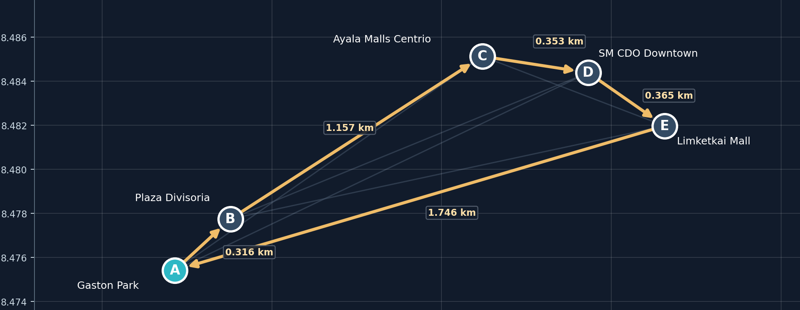
GREEDY TSP / CAGAYAN DE ORO
Labeled weighted graph and Greedy tour
Gold = chosen edges with weights (km). All candidate weights are in the matrix. NOT a street map.
TSP • Greedy Nearest Neighbor • educational straight-line model
06

Slide 7
GREEDY TSP / CAGAYAN DE ORO
Assigned algorithm: Greedy / Nearest Neighbor
INPUT: vertices, pairwise distances, starting vertex
1 start at A; mark A visited
2 while an unvisited vertex remains:
3 choose the nearest UNVISITED vertex
4 move to it; mark it visited
5 return to A to close the tour
OUTPUT: complete tour and total distance
LOCALLY BEST NEXT STEP
HEURISTIC, NOT A GENERAL PROOF
TSP • Greedy Nearest Neighbor • educational straight-line model
07

Slide 8
GREEDY TSP / CAGAYAN DE ORO
Manual walkthrough: nearest eligible next move
FROM
CHOOSE
KM
WHY
A
B
0.316
0.316 < 1.469, 1.670, 1.746
B
C
1.157
1.157 < 1.374, 1.483
C
D
0.353
0.353 < 0.687
D
E
0.365
only E remains
E
A
1.746
return to the start
Route length = 0.316 + 1.157 + 0.353 + 0.365 + 1.746 = 3.937 km
TSP • Greedy Nearest Neighbor • educational straight-line model
08

Slide 9
GREEDY TSP / CAGAYAN DE ORO
How the Python implementation works
1 • Read data
2 • Run Greedy
3 • Validate
Read TSP_Locations.csv and TSP_Distance_Matrix.csv; check IDs and symmetry.
From the current vertex, select the smallest distance among unvisited vertices.
Close the tour, recalculate every leg, and confirm each vertex appears exactly once.
Main program uses only the Python standard library; no external packages or APIs are needed.
TSP • Greedy Nearest Neighbor • educational straight-line model
09

Slide 10
GREEDY TSP / CAGAYAN DE ORO
LIVE PYTHON EXECUTION | show the real run
Run from the folder containing all CSV files:
python TSP_Greedy_Implementation.py
Show these outputs live: input locations and matrix → greedy selections → closed tour → sum of weights → validation.
Do not replace this demonstration with screenshots of code/output. Show actual execution while recording.
TSP • Greedy Nearest Neighbor • educational straight-line model
10

Slide 11
GREEDY TSP / CAGAYAN DE ORO
Result: a valid 5-location closed tour
A → B → C → D → E → A
MODEL DISTANCE
TOUR VALIDATION
3.937 km
5 unique vertices visited
Return to A: confirmed
Recalculated from the exact 0.001-km values in the CSV distance matrix.
TSP • Greedy Nearest Neighbor • educational straight-line model
11

Slide 12
GREEDY TSP / CAGAYAN DE ORO
Does Greedy guarantee the shortest route?
In general: NO
For this dataset: YES, verified
Nearest Neighbor makes decisions based on the shortest next edge. Early choices can force a longer closing edge. Its repeated scans take O(n²) time.
An optional independent exhaustive audit checked all 4! = 24 fixed-start tours. The minimum was 3.937 km, matching our Greedy total.
The exhaustive audit is verification only: the assigned solver remains Greedy Nearest Neighbor.
TSP • Greedy Nearest Neighbor • educational straight-line model
12

Slide 13
GREEDY TSP / CAGAYAN DE ORO
Limitations, improvements and conclusion
Limitations
Conclusion / next step
Straight-line distances are not real walking distances; accessibility and road geometry are ignored. Another dataset or starting point can yield a nonoptimal Greedy route.
Our Greedy program creates a valid closed tour and achieves 3.937 modeled km. A future version could replace proxy weights with Google Maps walking/driving travel distances.
Answer the problem as modeled, not as an unrestricted claim about actual street travel.
TSP • Greedy Nearest Neighbor • educational straight-line model
13

Slide 14
GREEDY TSP / CAGAYAN DE ORO
References and map verification
Assigned algorithm source
“2.7 Greedy Algorithm,” The Mindanao Journal of Mathematics, Vol. 6 (2024), no. 2, pp. 79–111; excerpt at pp. 88–89.
Location / coordinate references
Gaston Park & Limketkai: Mapcarta / OpenStreetMap. Plaza Divisoria & Centrio: Wikipedia coordinates. SM Downtown: Wikidata.
Google Maps
OPEN ROUTE IN GOOGLE MAPS - WALKING PREVIEW >
Google Maps preview is for geographic context; numerical model weights come from coordinate calculations, not Maps directions.
TSP • Greedy Nearest Neighbor • educational straight-line model
14

